Slide 1


Willow Livengood
Harry Chong
Paras Doshi
Hai Le

Slide 2
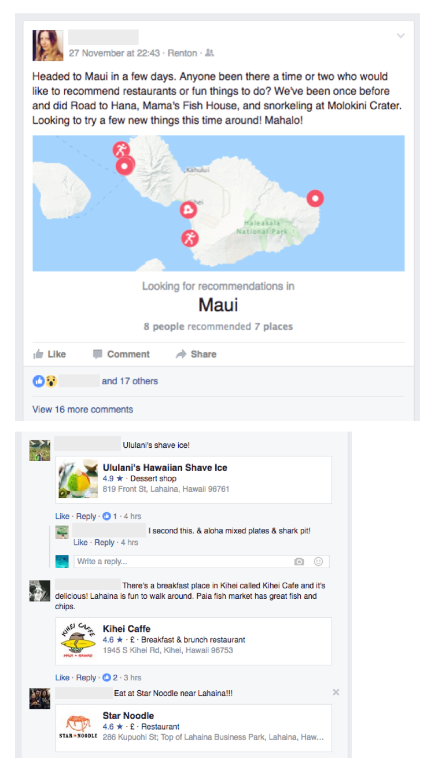
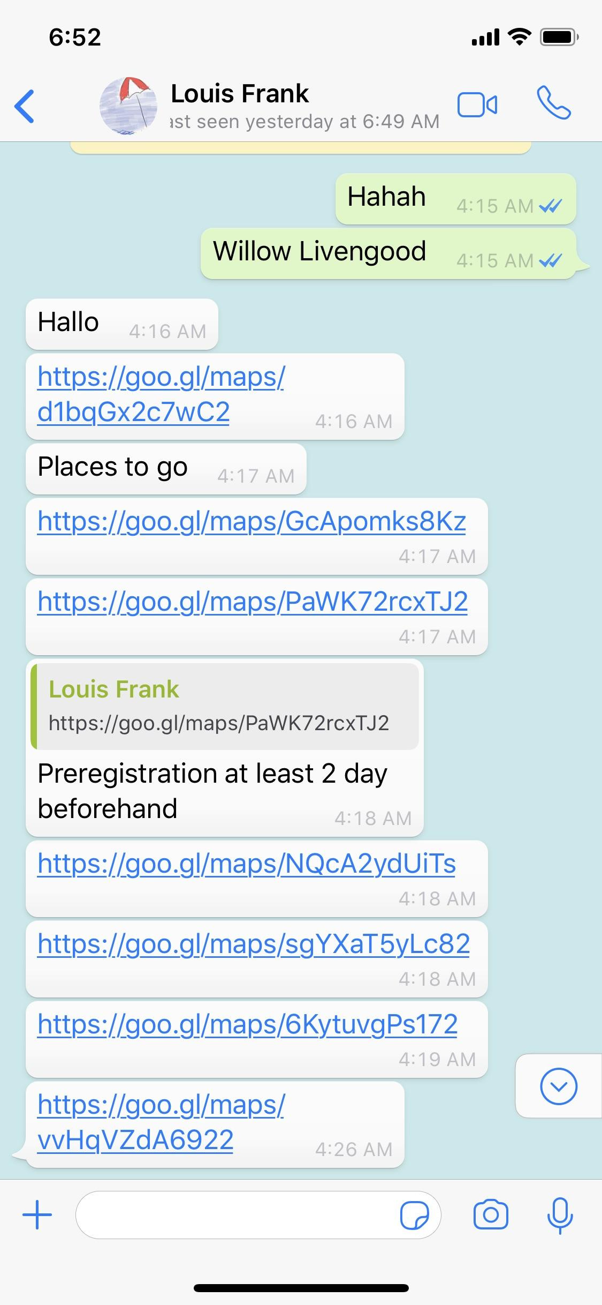
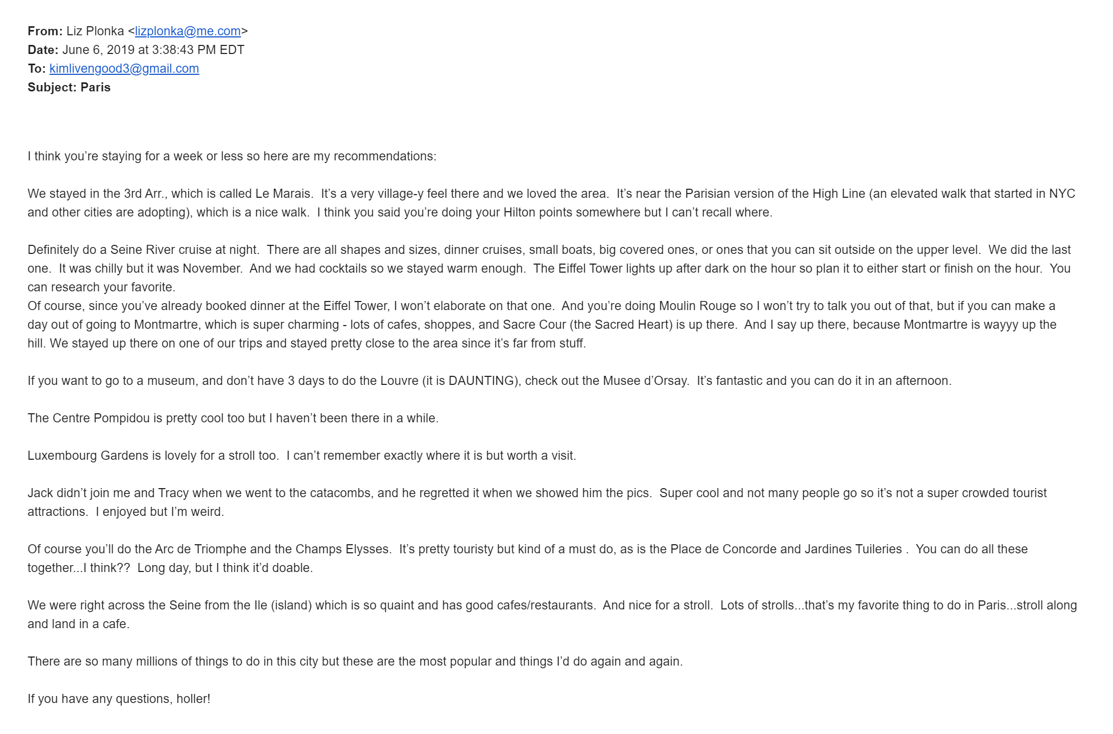
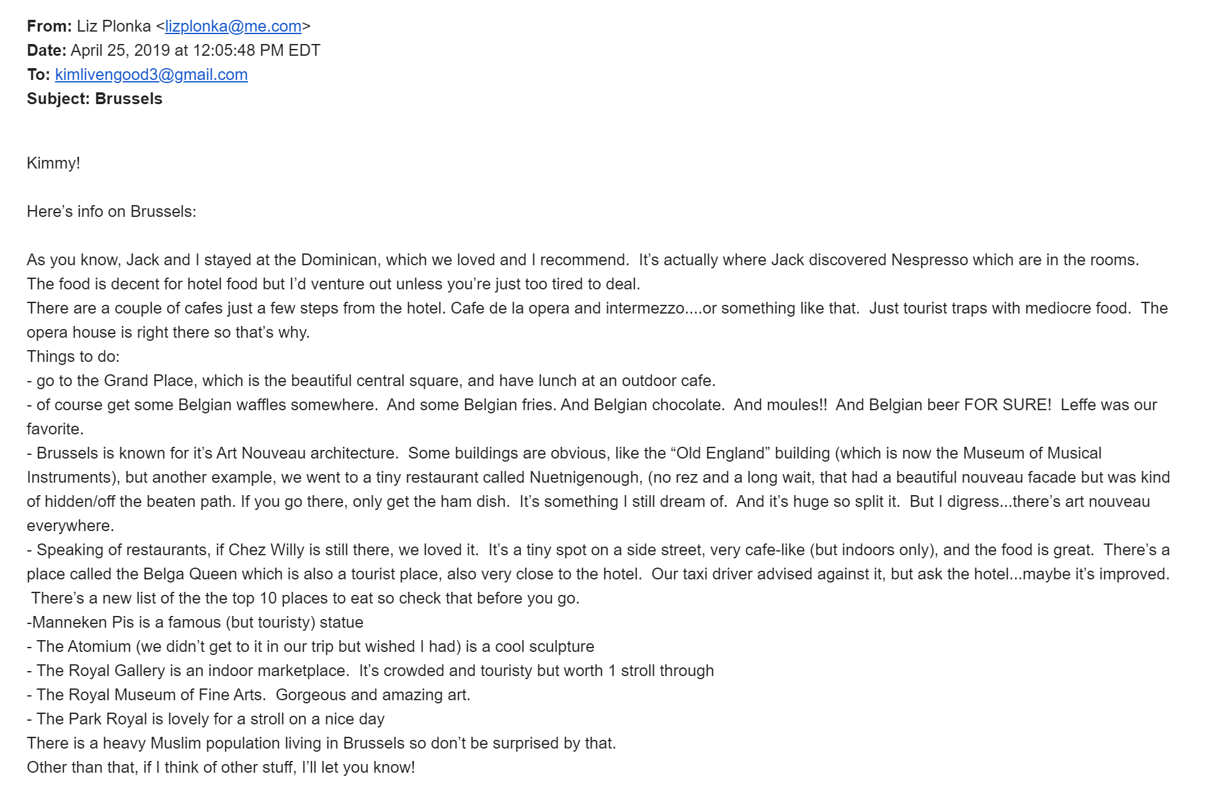
Are you planning to travel?
Do you have friends with recommendations for these places?
Are they all easy to find, access and read on the go?
Notes:
Just restate what trip tips is

Slide 3

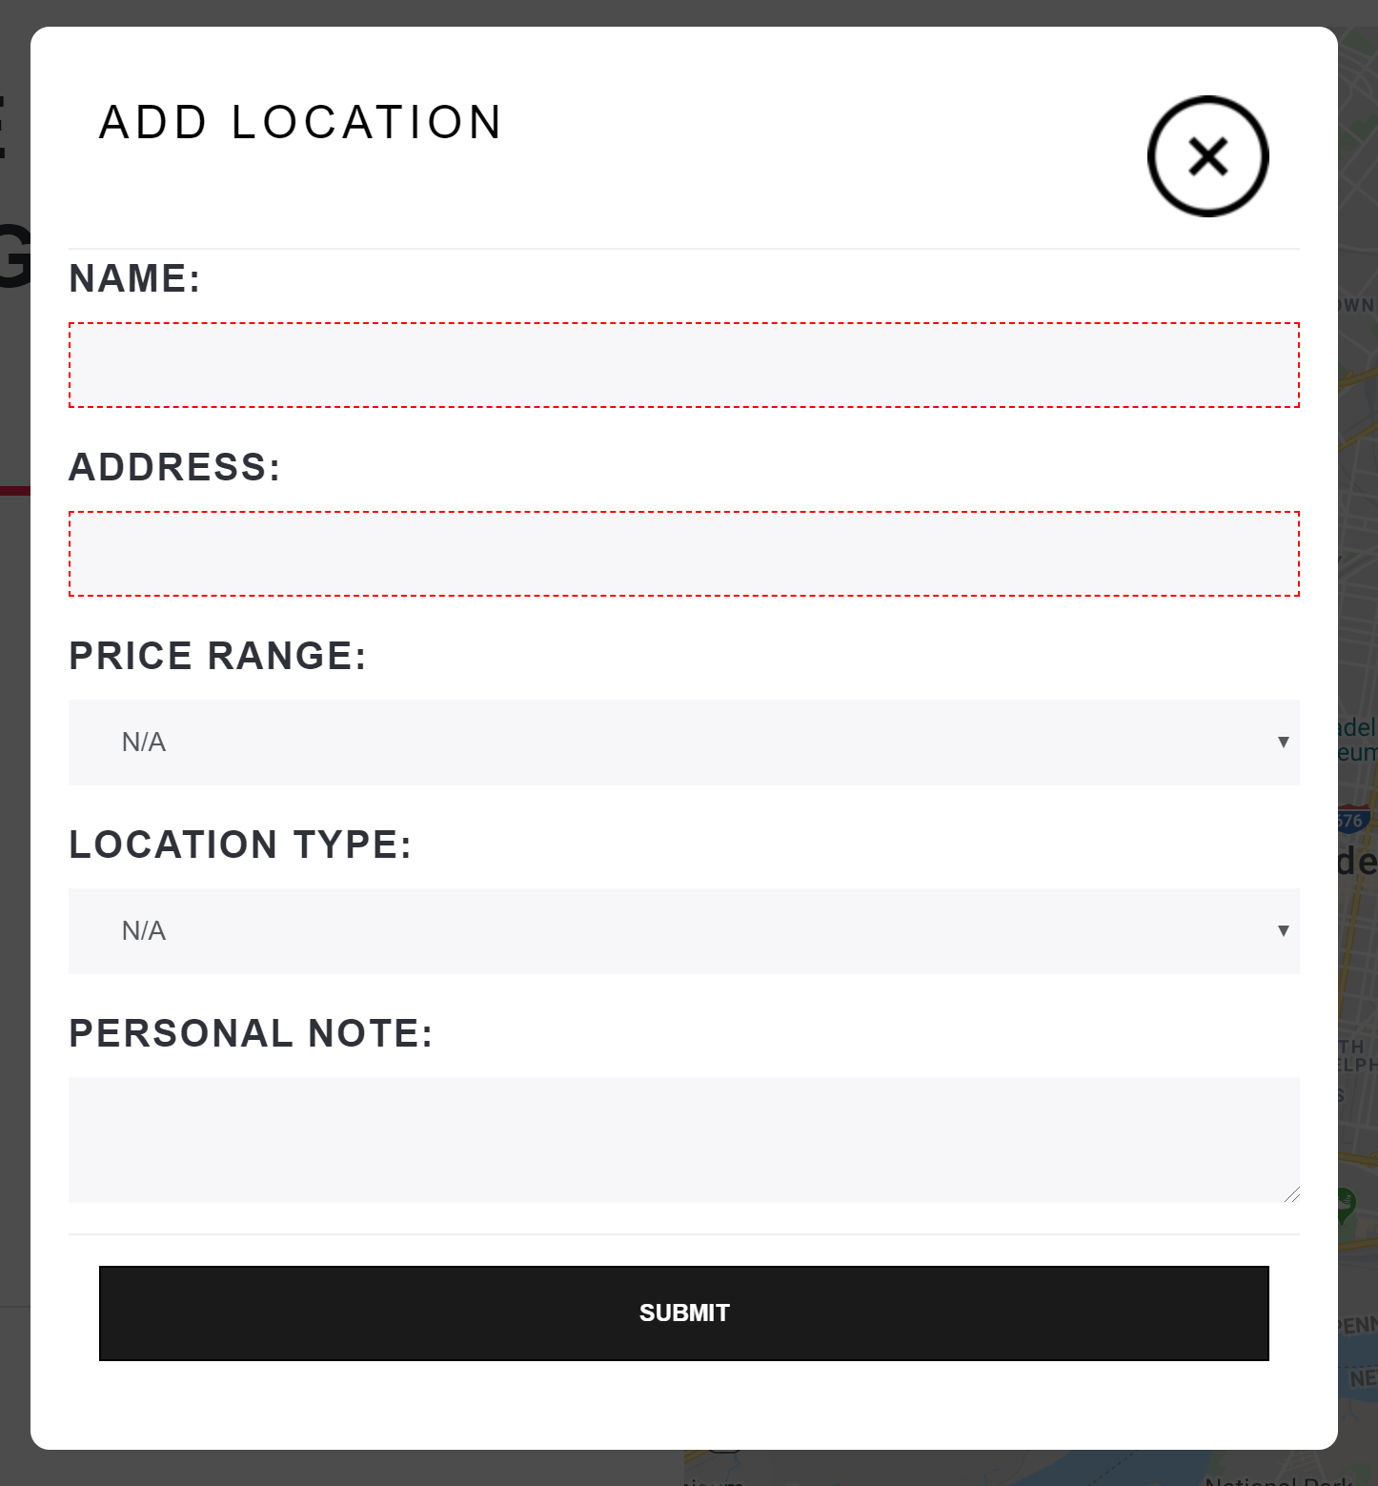
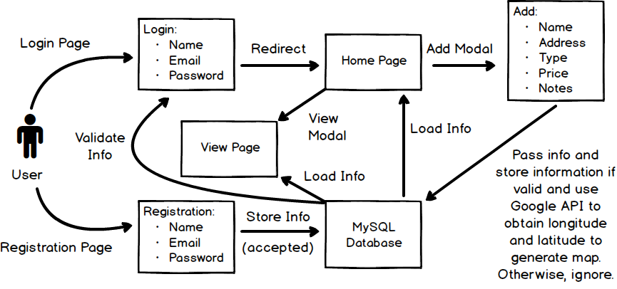

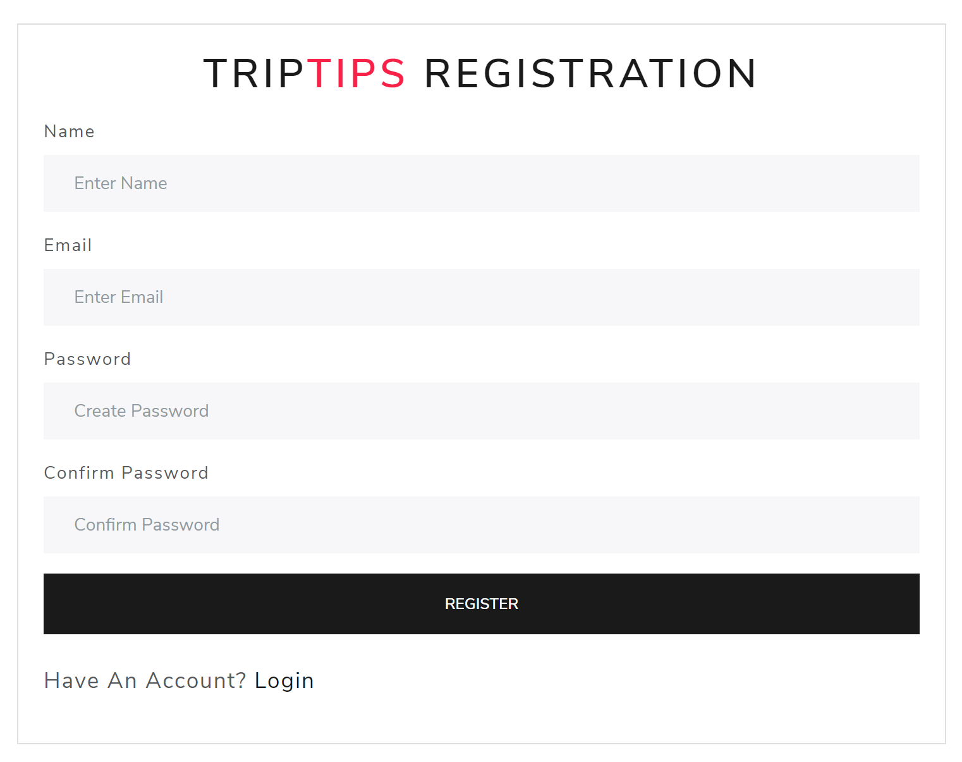
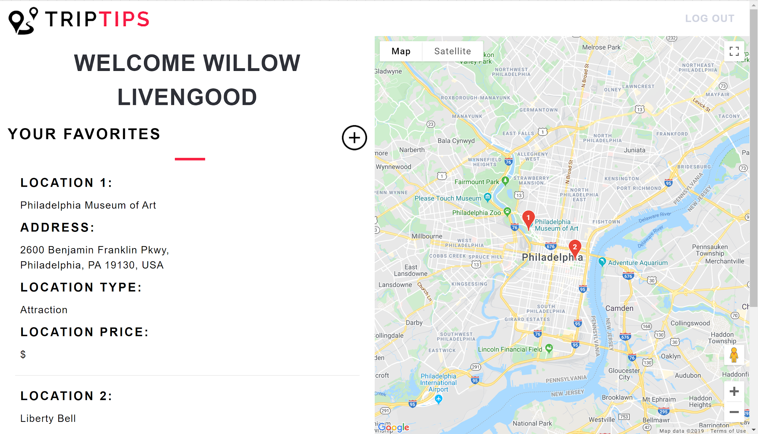
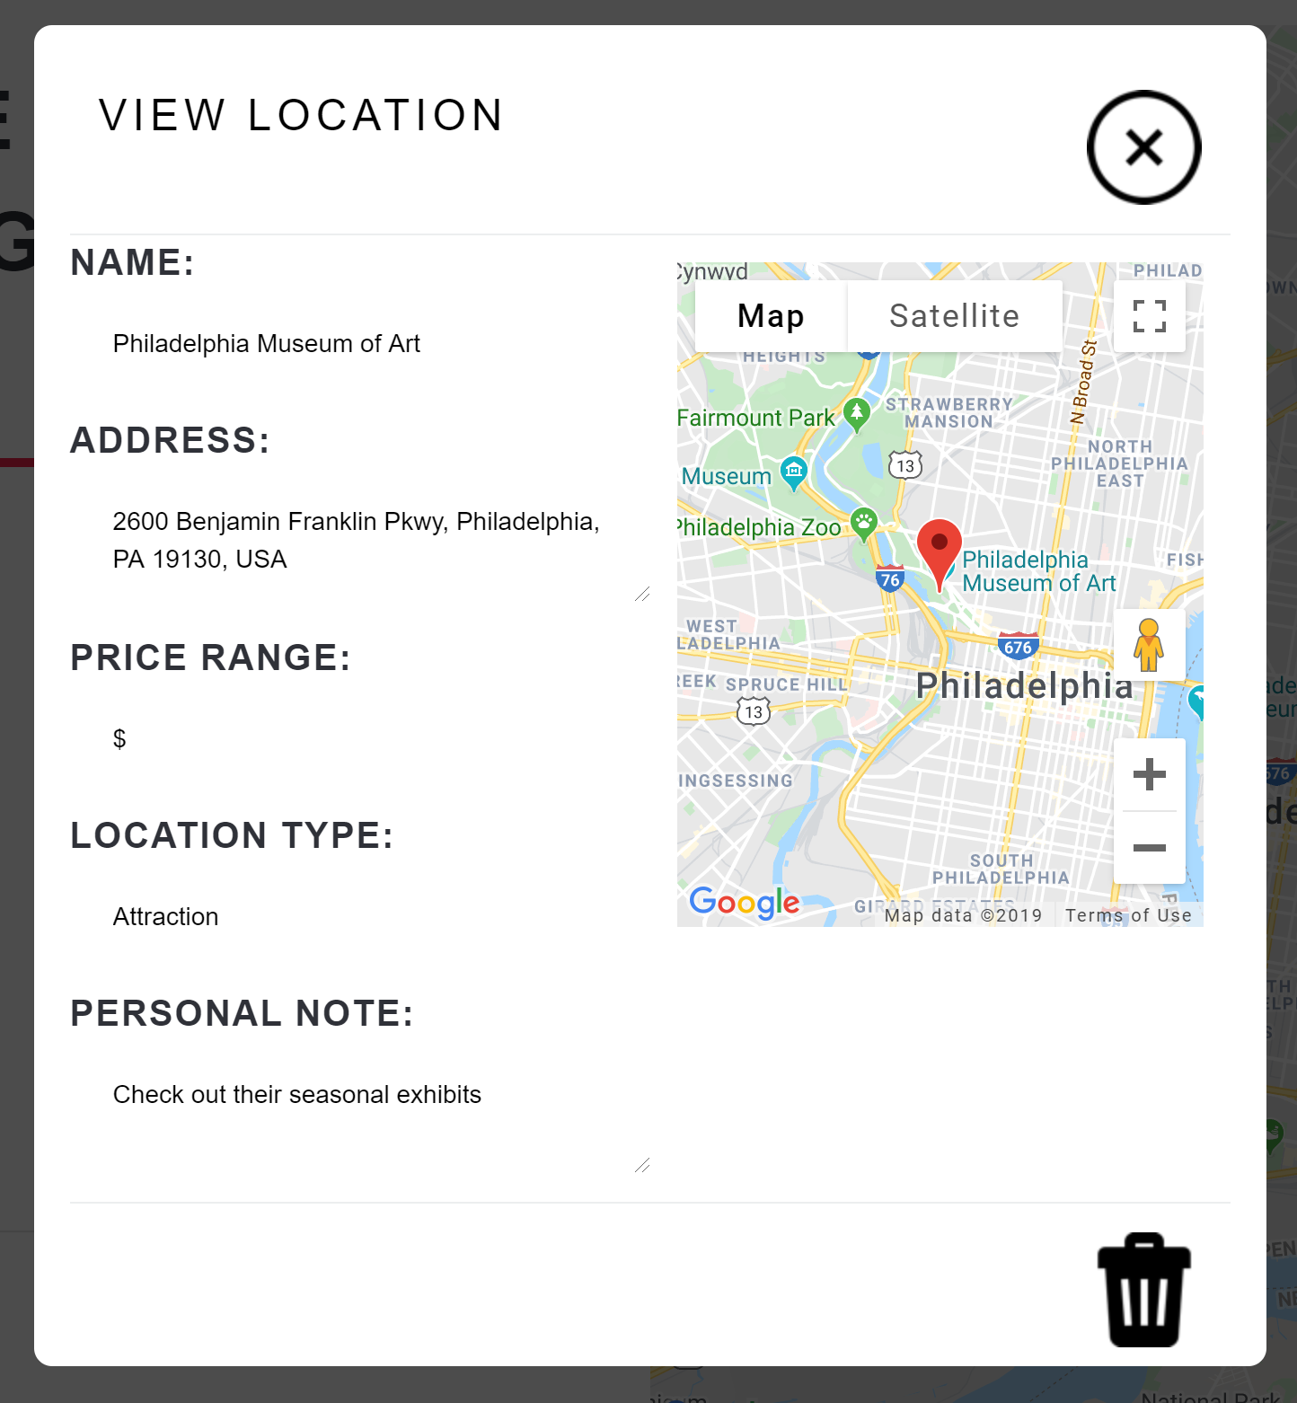
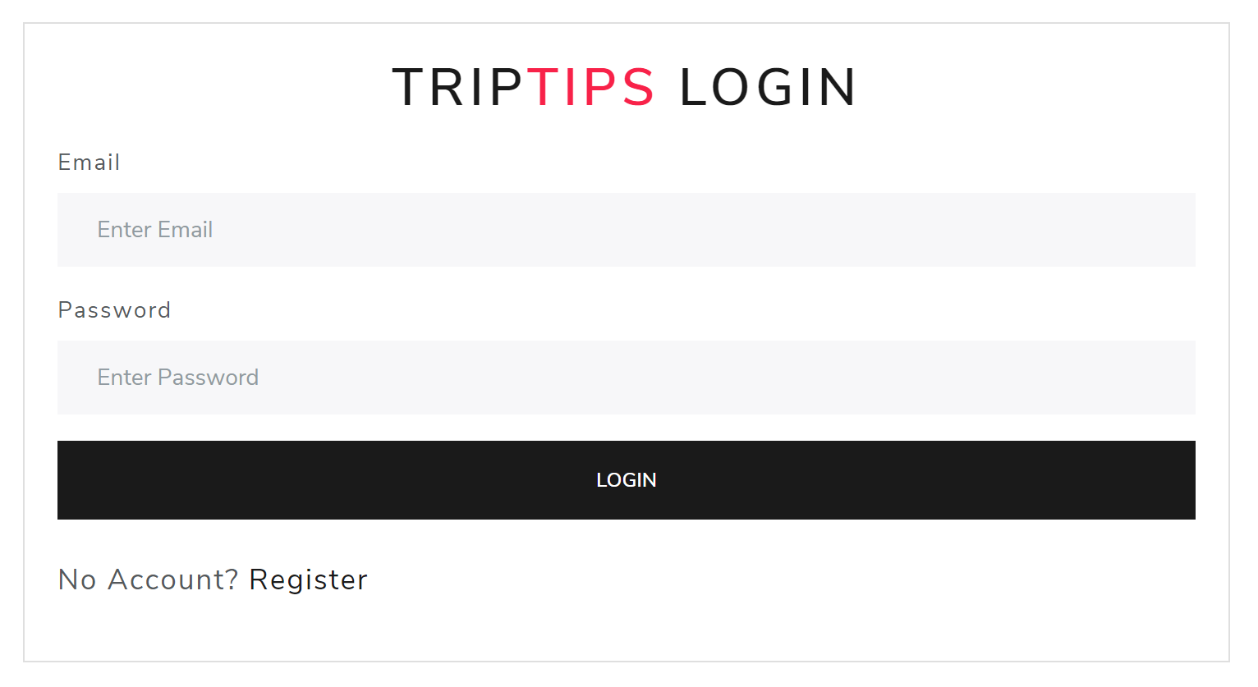
App Overview
Notes:
Go over the functionality

Slide 4






Technology used
Frontend:
HTML
CSS (Bootstrapping)
EJS (Embedded JavaScript Templates)
Backend:
Node.js
Javascript
AJAX
JSON
MySQL database
Passport.js
Google Geocoding API
Google Maps API

Slide 5

Database and Endpoints
User Table
Structure of database
Users database
Locations database
Endpoints:
Registration endpoint
Login endpoint
Logout Endpoint
Getting user location endpoint
Posting user location endpoint
Delete user location endpoint
Retrieving geolocation endpoint
User Id
Name
Email
Password
Date
TripTips Database
Users table
Locations table
Location Table
Location Id
Location Name
Location Address
Location Type
Location Price
Location Notes
Location Longitude
Location Latitude
User Id
Notes:
Go over the way we designed database and the endpoints we used

